Slide 1
Module 6
Data Visualization

Slide 2
Objectives
Uses for array.array instead of list
numpy.ndarray is even better than array.array
Learn basic plotting with matplotlib

Slide 3
Arrays vs. Lists (1 of 2)
Lists in Python are sequences of pointers
Each pointer refers to an object elsewhere in memory
This is how Python supports lists with mixed types of entries
Real arrays don’t do this
They store the values (not pointers) contiguously in memory
But in Python they can only store numeric values (bool, int, float, character codes)
And they all have to be the same type
Arrays use less memory than lists
array.array isn’t necessarily faster than lists, however
For efficient numerical arrays, we use numpy.ndarray
Notes:
Illustrated in pythontutor.org on next slide.

Slide 4
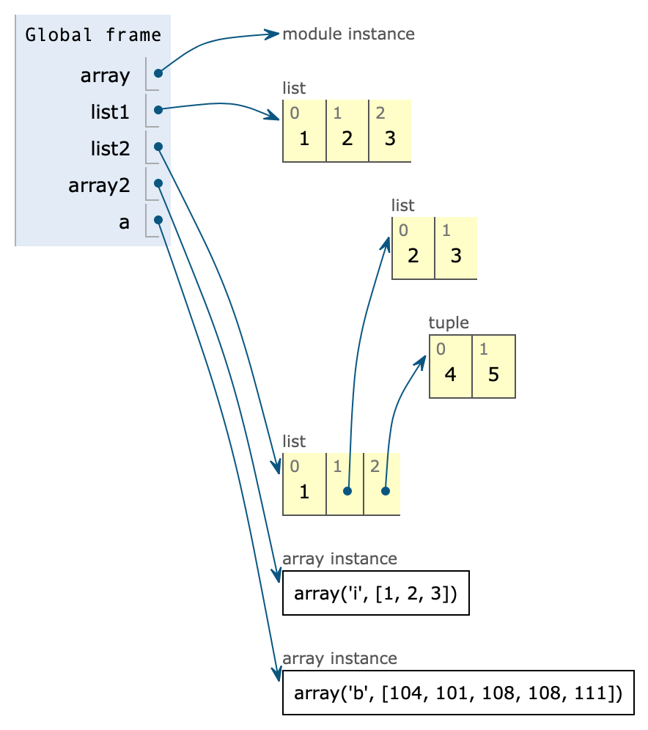
Arrays vs. Lists (2 of 2)
import array
list1 = [1,2,3]
list2 = [1,[2,3],(4,5)]
array2 = array.array('i',[1,2,3])
a = array.array('b')
a.frombytes(b"hello")
The array a uses only 5 bytes for its data!

Slide 5
Basic Types for array.array
Type Code | Python Type | Size in Bytes
‘b’ | int | 1
‘h’ | int | 2
‘i’ | int | 2 or 4
‘l’ (letter “ell”) | int | 4
‘q’ | int | 8
‘f’ | float | 4
‘d’ | float | 8

Slide 6
array.array Supports Most List Operations
Supports:
append, count, extend, index, insert, pop, remove, reverse, +
Does not support:
clear, copy, sort
So you pretty much use it like you do a list
Except you call array.array(‘type-code’) to create an array
With an optional initializer sequence, as shown

Slide 7
numpy.ndarray
The third-party module numpy has support for mathematical array processing and data analysis
It has an even better array type: ndarray
You can operate on it all at once instead of only element-by-element!
Makes multi-dimensional arrays easy to use
If you don’t use Thonny, you have to install numpy separately:
> pip install numpy or > python –m pip install numpy
(see https://www.liquidweb.com/kb/install-pip-windows/ for Windows help)
Use pip3 instead of pip on mac os
On Thonny you can use the Package Manager
Can create ndarrays from initial values with the numpy.array function…
Notes:
Illustrate installing numpy.

Slide 8
Using numpy.ndarray Code/nptest.py
import numpy as np
a = np.array(range(10),’i2’) # Optional type-spec (‘i2’ = int16)
print(a)
print(-a)
print(a+1)
print(a.dtype,a.itemsize,a.size,a.nbytes,a.shape)
b = np.array([[1,2,3],[4,5,6]]) # Type inference
print(b,b.shape)
print(b[1],b[1].shape)
print(b[0]*b[1])
[0 1 2 3 4 5 6 7 8 9]
[ 0 -1 -2 -3 -4 -5 -6 -7 -8 -9]
[ 1 2 3 4 5 6 7 8 9 10]
int16 2 10 20 (10,)
[[1 2 3]
[4 5 6]] (2, 3)
[4 5 6] (3,)
[ 4 10 18]
You can use numpy.ndarray for Project 6.
Notes:
If you leave off ‘i2’, you will get int64 = ‘i8’ by default for a. The itemsize would be 8 in that case.
Consider doing this in pythontutor.com.

Slide 9
Common numpy.ndarray Types
Type Code | Meaning
‘?’ | bool
‘b’ | byte
‘i’ | int
‘f’ | float
‘c’ | complex
The last 3 types above can be suffixed with byte size:
‘i4’ = 4-byte (32-bit) integer
‘f8’ = double-precision floating-point number
etc.

Slide 10
Dot Product in numpy
# dot.py: Shows different ways to compute a dot product
import numpy as np
from functools import reduce
print(1*5 + 2*6 + 3*7 + 4*8) # The worst way
# A better way
a = [1,2,3,4]
b = [5,6,7,8]
result = 0
for i in range(len(a)):
result += a[i]*b[i]
print(result)
# An okay way (if it makes sense to you)
print(reduce(lambda sofar,p: p[0]*p[1]+sofar, zip(a,b), 0))
a = np.array([1,2,3,4])
b = np.array([5,6,7,8])
# The second-best way
print(sum(a*b))
# The best way
print(np.dot(a,b))

Slide 11
Copying a ndarray
Warning: Slices of ndarrays don’t make copies!
Use .copy( ) to make a copy.
Notes:
Because numbers are simple values and have no deeper data.

Slide 12
arange and reshape
arange: a range function that returns a ndarray
Useful for creating data for plotting
reshape: can transform an ndarray into a matrix
>>> x = np.arange(12)
>>> x
array([ 0, 1, 2, 3, 4, 5, 6, 7, 8, 9, 10, 11])
>>> y = x.reshape(2,6)
>>> y
array([[ 0, 1, 2, 3, 4, 5],
[ 6, 7, 8, 9, 10, 11]])
>>> y.reshape(3,4)
array([[ 0, 1, 2, 3],
[ 4, 5, 6, 7],
[ 8, 9, 10, 11]])
>>> y.reshape(2,2,3) # 3-dimensions!
array([[[ 0, 1, 2],
[ 3, 4, 5]],
[[ 6, 7, 8],
[ 9, 10, 11]]])
Notes:
Data analysis typically uses tables which are 2-d arrays.

Slide 13
linspace
Useful for creating an evenly spaced range of numbers
Used for x-coordinates in plotting
The above creates 25 equal-sized spaces (with 26 numbers altogether including both ends) between 0 and 100 inclusive
So if you want n intervals, you need to specify n+1 points
>>> np.linspace(0,100,26)
array([ 0., 4., 8., 12., 16., 20., 24., 28., 32., 36., 40.,
44., 48., 52., 56., 60., 64., 68., 72., 76., 80., 84.,
88., 92., 96., 100.])

Slide 14
Reading Numbers From a Text File
Fast and easy with numpy.loadtxt
Each row in the file must have the same number of values
The code below reads one of the files from Project 6
Note that it assumes float by default, but we want int in Project 6
>>> a = np.loadtxt('as_ch01-0537xx_Record1042.dat')
>>> len(a)
3072
>>> a
array([ 0., -36., -36., ..., -52., -8., -24.])

Slide 15
The matplotlib Module
You will also need to install this
> pip install matplotlib or $ python3 –m pip install matplotlib
Supports 2-dimensional plots of data values and equations
Also supports:
Multiple colors
Labels and titles
Axis tick marks
Multiple subplots in the same plot
Legends
Multiple line styles

Slide 16
Review Project 6 Spec Now
Observe the plots

Slide 17
Usng glob.glob to Discover Files in a Folder
The glob module has a glob method
You give it a file path wildcard expression
It responds with the names of the matching files
Wildcards:
* matches 0 or more occurrences of any character
? matches exactly one character
> dir *.dat on Windows
$ ls *.dat
2_Record2308.dat as_ch01-0537xx_Record1042.dat
2_Record3388.dat
>>> import glob
>>> glob.glob("*.dat")
['as_ch01-0537xx_Record1042.dat', '2_Record2308.dat', '2_Record3388.dat']
Notes:
Could demo this live in a command shell.

Slide 18
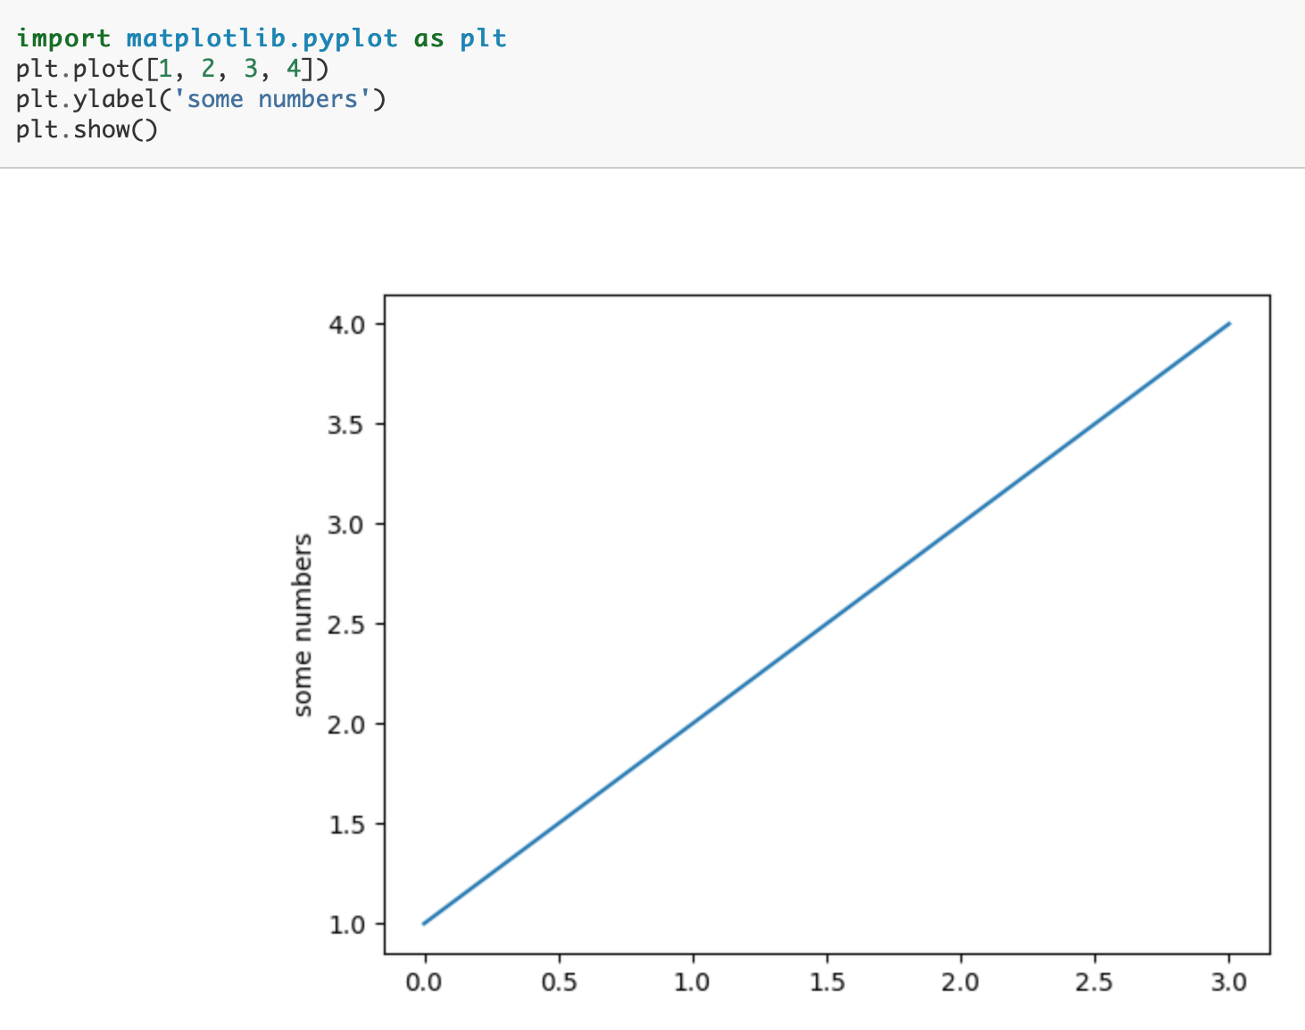
pyplot
A class in matplotlib
This is the main class we use to plot data
Plots through the points:
(0,1)
(1,2)
(2,3)
(3,4)
Notes:
The list positions become the x values by default.

Slide 19
A Second Plot
_,axis = plt.subplots() # Defaults to one axis
axis.plot([10,15,5,7,0,40])
axis.set(title="A simple line plot of y values")
plt.show()

Slide 20
The Nature of Floating-point Numbers Remember This?
They only approximate real numbers
They are spread further apart as the numbers get larger
>>> x = 9223372036854775808.0
>>> print(f"{(x - 512):f}")
9223372036854775808.000000
>>> print(f"{(x - 513):f}")
9223372036854774784.000000
>>> print(f"{((x-512) - (x-513)):f}")
1024.000000

Slide 21
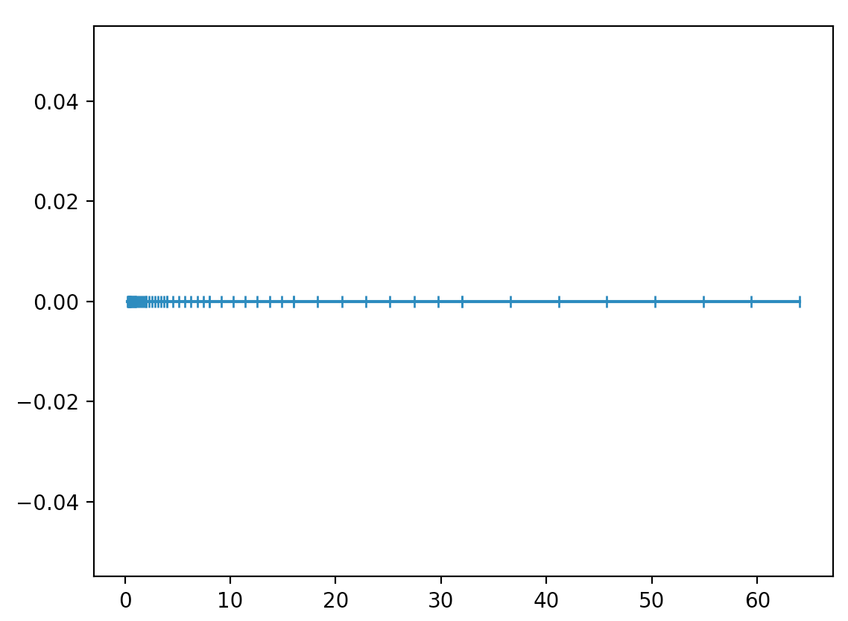
Illustrating FP Number Distribution
How would we plot the graph below?
There are 8 evenly spaced numbers (7 spaces) between successive powers of 2

Slide 22
The matplotlib code
x0 = np.linspace(.25,.5,8)[:-1]
x1 = np.linspace(.5,1.0,8)[:-1]
x2 = np.linspace(1.0,2.0,8)[:-1]
x3 = np.linspace(2.0,4.0,8)[:-1]
x4 = np.linspace(4.0,8.0,8)[:-1]
x5 = np.linspace(8.0,16.0,8)[:-1]
x6 = np.linspace(16.0,32.0,8)[:-1]
x7 = np.linspace(32.0,64.0,8)[:-1]
x = np.concatenate((x0,x1,x2,x3,x4,x5,x6,x7))
y = np.zeros(len(x)) # Set y’s to 0
_, ax = plt.subplots()
ax.plot(x,y,marker='|')
plt.show()

Slide 23
Legends and Line Styles
_,axis = plt.subplots()
xs = range(1,20)
ys = [x**2 for x in xs]
# Labels go in the legend
axis.plot(xs,ys,label="x**2")
ys3 = [x**3 for x in xs]
# r = red, -- = dashed line
axis.plot(xs,ys3,'r--',label="x**3")
# Create and place legend
axis.legend(loc="best")
plt.show()

Slide 24
Multiple Graphs in One Plot
Done by having multiple axes
Each axis is its own graph
You need this for Project 6
Note the subscripting on axes below
_,axes = plt.subplots(nrows=2)
xs = range(1,20)
ys = [x**2 for x in xs]
axes[0].plot(xs,ys)
axes[0].set(title="Multiple axes",ylabel="x**2",xticks=[])
ys3 = [x**3 for x in xs]
axes[1].plot(xs,ys3,'r--')
axes[1].set_ylabel("x**3")
plt.savefig("plot4.pdf") # Save plot to a PDF file

